Slide 1

Data Cleaning
Notes:
In this video, we’ll learn what data cleaning is and why it is so important!

Slide 2

Data Cleaning
Data cleaning is the process of fixing or removing incorrect, corrupted, incorrectly formatted, duplicate, or incomplete data within a dataset.
DATA
Notes:
There’s a saying in data science of “garbage in - garbage out”. What this means is that if you data is not good, or messy to begin with, then any analysis done with that data or conclusions made from the data will also be not good. This is why data scientists take a long time in cleaning and preparing their data. Data cleaning deals with fixing or removing incorrect or missing values. You might think that it would be best to simply remove entries with missing data. It would definitely be easier to do this but using an incomplete dataset will also impact the results of your analysis. One of the main aims of data cleaning is to keep as much of a dataset intact as possible. There are a few things that we can check for and fix to clean our data.

Slide 3
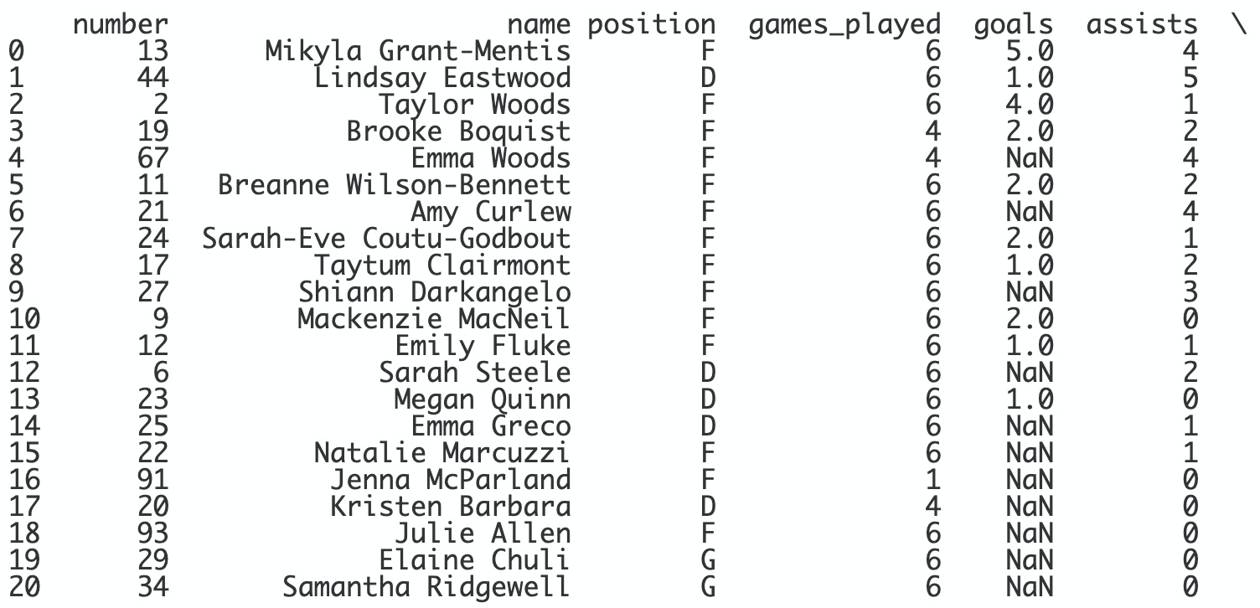
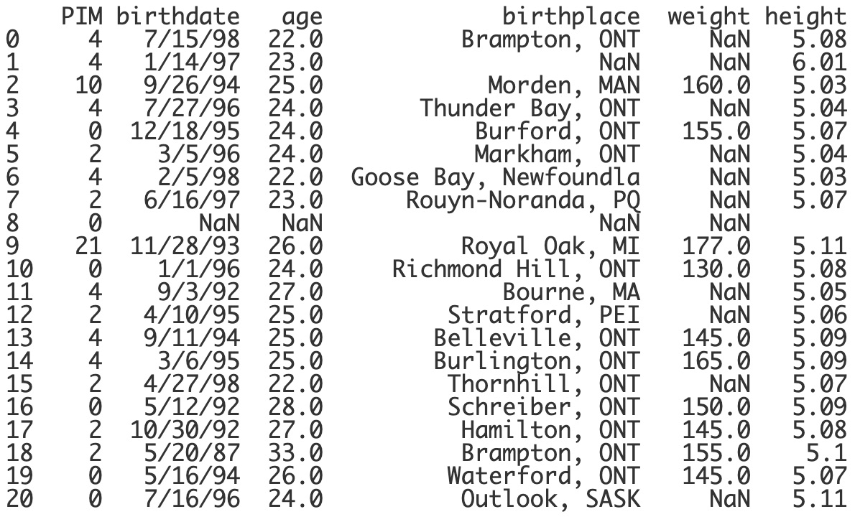
Missing Values
Imputation is the process of replacing missing data with substituted values.
Notes:
A big part of data cleaning is deciding how to deal with missing values. This is a dataset containing statistics of the 2020-2021 WNHL team the Toronto Six. There are a lot of missing values. The missing values show up as NaN which stands for Not A Number. If a value is missing because it doesn't exist then it might just make sense to keep a number as NaN. On the other hand, if a value is missing because it wasn't recorded, then you do have a few options of how to fill in the missing value based on the other values in that column or row. This is called imputation. Let’s take a look at a few options that we have.

Slide 4
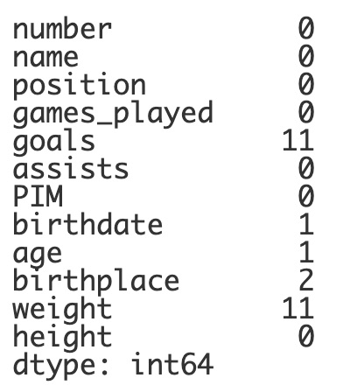
Missing Values
print(df.isnull().sum())
What does it do?
Lists the number of null values in each column.
Notes:
The pandas library includes a function called isnull(). Null is another way to say empty or missing. The isnull function will list whether or not a value is missing. When paired with the sum function, we can print out a list of how many null values are in each column. You can see here that there are a lot of missing values in the goals and the weight columns of the data.

Slide 5
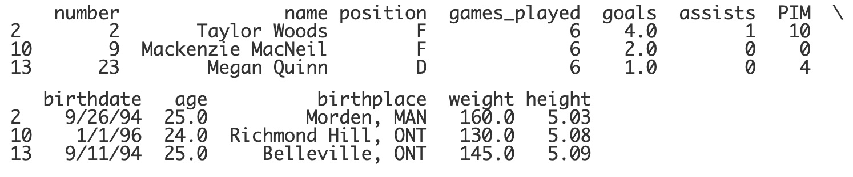
Dropping Columns/Rows
print(df.dropna())
What does it do?
Drops all rows that have a missing value.
Notes:
We have the option of simply dropping the columns or rows that contain missing values. This might be okay if the columns or rows are not critical to the analysis of the data. The function dropna will drop all rows that contain missing values. For our WNFL data, this doesn’t seem to be a good option, as it only leaves three teammates in the data!

Slide 6
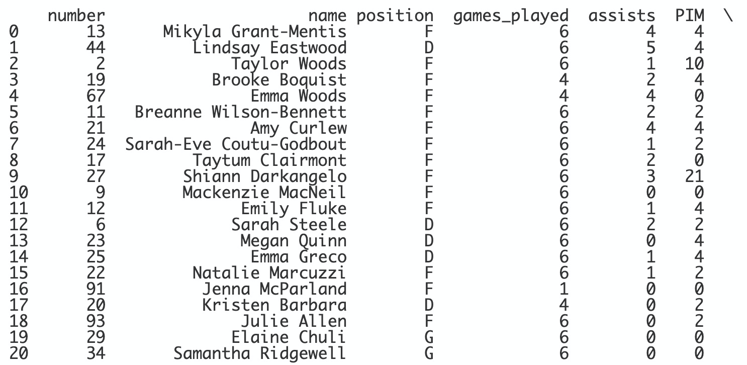
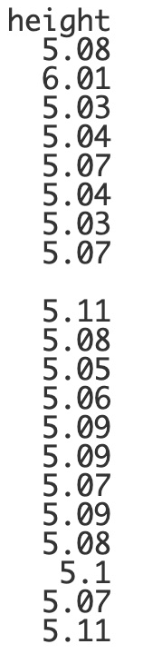
Dropping Columns/Rows
print(df.dropna(axis=1))
What does it do?
Drops all columns that have a missing value.
Notes:
We can add the parameter axis=1. Whenever this is added as a parameter, the function will act on the columns instead of the rows. Here is the data will all of the columns containing missing values dropped. This is better, but it dropped the goals column. The amount of goal scored is important data that we should keep.

Slide 7
Dropping Columns/Rows
print(df.drop(["birthdate", "birthplace", "weight"],
axis=1, inplace=True)
What does it do?
Drops specific columns or rows.
Notes:
Instead of using dropna, we can use the drop function and specify which columns or rows that we’d like to drop. Let’s say that the birth date, the birthplace and the weight columns are not important for our analysis. We can specify those columns.

Slide 8
Dropping Columns/Rows
print(df.drop(["birthdate", "birthplace", "weight"],
axis=1, inplace=True)
What does it do?
Drops specific columns or rows.
Notes:
We have to include axis=1 to denote that we are dropping columns and not rows.

Slide 9
Dropping Columns/Rows
print(df.drop(["birthdate", "birthplace", "weight"],
axis=1, inplace=True)
What does it do?
Drops specific columns or rows.
Notes:
And because this is our final decision, we can add inplace=True to make this change permanent.

Slide 10
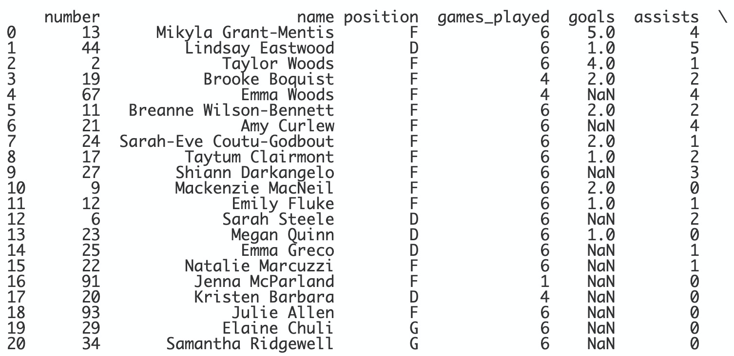
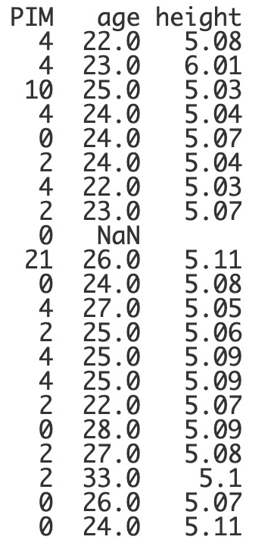
Dropping Columns/Rows
print(df.drop(["birthdate", "birthplace", "weight"],
axis=1, inplace=True)
What does it do?
Drops specific columns or rows.
Notes:
Great. This looks much better so far.

Slide 11
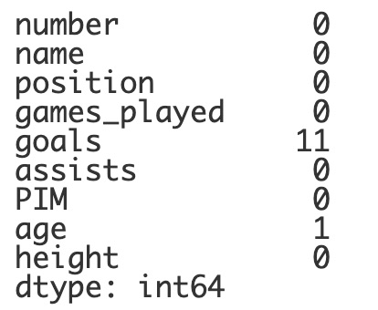
Missing Values
print(df.isnull().sum())
Notes:
Now, if we check on the null values, we see that we still need to figure out how to replace the missing goals and the missing age.

Slide 12
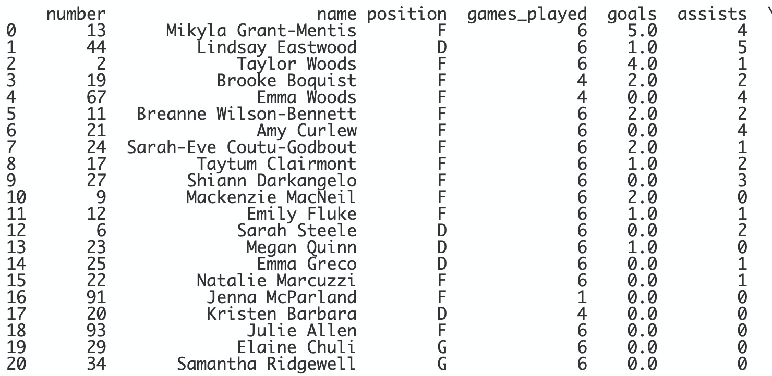
Missing Values
print(df.goals.fillna(0, inplace=True))
print(df["goals"].fillna(0, inplace=True)
What does it do?
Fills missing values with a specific value.
Notes:
We can choose to replace missing values with a value of our choice. In the case of goals in this data, we might notice that the values that are missing really should be zero for zero goals. Remember that we can use dot notation or bracket notation. Bracket notation would be needed if you wanted to fill missing values in more than one column. Again, we use the inplace=True parameter since this is our final decision. Looks great! We’ve replaced all of the NaNs in the goals column.

Slide 13
Missing Values
Command | What does it do?
df.fillna(method="bfill") | Fills the missing value with the value in the row or column behind it.
df.fillna(method="ffill") | Fills the missing value with the value in the row or column in front of it.
Notes:
It might not always make sense to fill in all of the missing values with the same value. Sometimes it’s better to fill in the missing value with a closeby value, like the value before or after it. We can use the method parameter and either the bfill or ffill option to fill in the missing value with the value that comes directly before or after it. Let’s see this in action.

Slide 14
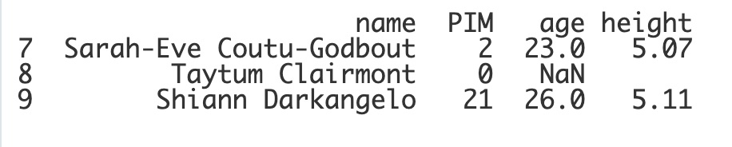
Missing Values
NaN
Notes:
Here is a filtered list that just displays the values surrounding the missing value in the age column. You might notice that there is a missing value in the height column as well - but it’s not listed as a NaN. We’ll talk about this in just a bit.

Slide 15
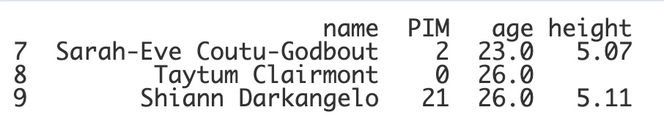
Missing Values
print(df.fillna(method="bfill"))
NaN
Notes:
Our first option would be to fill in the missing age with the value that comes one row after it. This would fill the value in as 26.

Slide 16
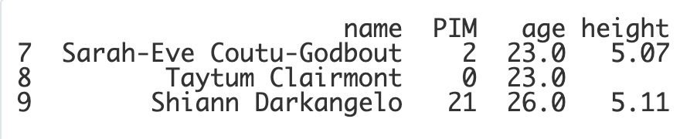
Missing Values
print(df.fillna(method="ffill"))
NaN
Notes:
Or, we can use the ffill option and fill it in with the value that is in the row right in front of it which would fill it in with a 23. Now, in this example use the rows before or after make the most sense since they are also age values. However, in other data sets it might make more sense to fill in the missing value with a value in the column before or after it.

Slide 17
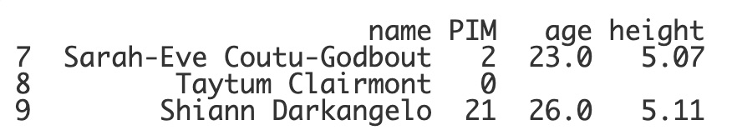
Missing Values
print(df.fillna(method="bfill"),axis=1)
NaN
Notes:
Let’s see what would happen in our dataset. If we add in the axis=1 parameter, the bfill method will fill in the missing value with the value in the column after it. This would fill in the age as an empty cell. Again, we’ll explain why this is empty in just a bit.

Slide 18
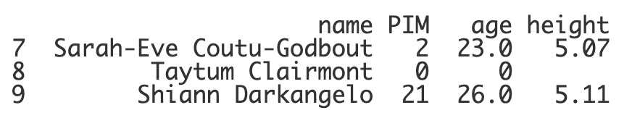
Missing Values
print(df.fillna(method="ffill"),axis=1)
NaN
Notes:
Lastly, we could use the ffill method instead and fill in the value with the value in the column before it, making the missing age 0. Well, none of this really makes sense in our specific data, so what other options do we have?

Slide 19
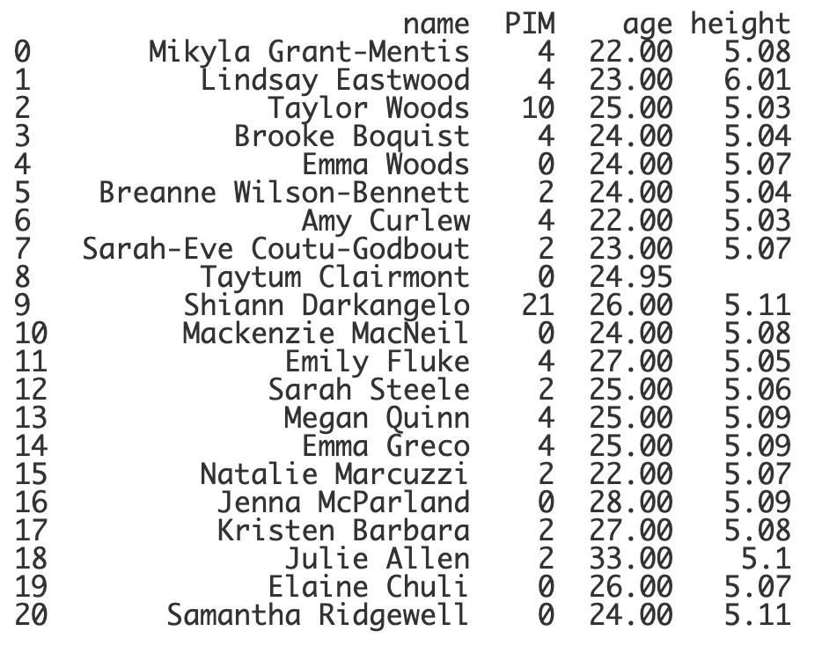
Missing Values
average_age = df.age.mean()
print(df.age.fillna(average_age))
Notes:
What we COULD do is find the average age of the team. This would be, in most cases, acceptable depending on what we are ultimately going to do with the data. We can use the mean function to find the average age and then the fillna function to fill in the missing value with the average. And if all of this looks good, then

Slide 20
Missing Values
average_age = df.age.mean()
print(df.age.fillna(average_age,
inplace=True))
Notes:
We can add in the inplace=True parameter. Now, let’s get to that missing height value. Why is it blank instead of NaN?

Slide 21
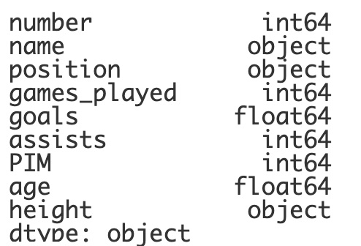
Incorrect Data Types
print(df.dtypes)
Notes:
Another important aspect of cleaning your data, is checking on the data types of your data table. If you plan on using values for mathematical analysis, you’ll want to make sure that the data is being stored as integers or floats instead of strings or objects. Here, we can see that age is listed as a float and the height is actually listed as an object, or a string! We’ll want to fix these.

Slide 22
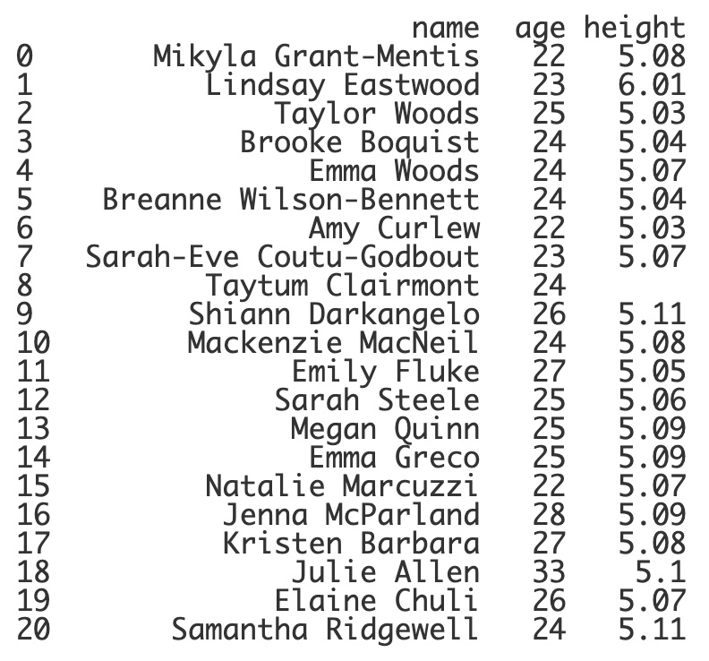
Incorrect Data Types
df.age = df.age.astype(int)
print(df[["name","age","height"]])
What does it do?
Changes the data type of the values in the column to int, str, float, etc.
Notes:
Keeping age as a float might be okay, but we can change it to an integer instead by using the astype function. We can use this function to change the data types of the values in the dataset. Changing the age to an integer has definitely made the column neater and easier to read. Notice how it didn’t round the average age, which was 24.95 but rather just dropped the decimal portion. We’ll come back to this a little later.

Slide 23
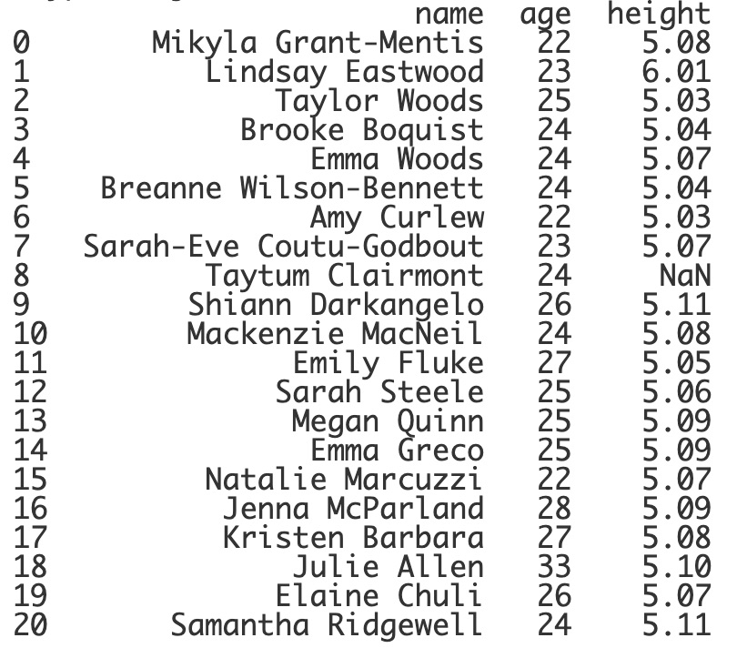
Incorrect Data Types
df.height = pd.to_numeric(df.height)
print(df[["name","age","height"]])
What does it do?
Changes the data type of the values in the column to either an int or float.
Notes:
Another function called to_numeric can be used to convert data to the correct numeric type, either integer or float. Now, we can see that the empty string value has changed to NaN.

Slide 24
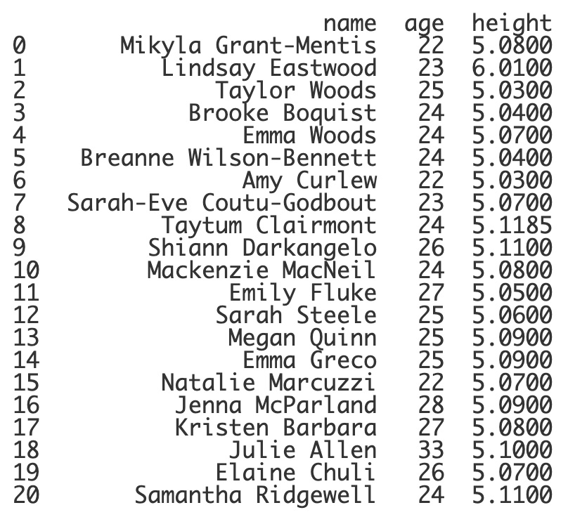
Incorrect Data Types
average_height = df.height.mean()
df.height.fillna(average_height,
inplace=True)
print(df[["name","age","height"]])
Notes:
Now that the height is the correct data type, we can find the average height and fill in the missing value with it. Woah - doing this added a few more decimal places. We can fix this.

Slide 25
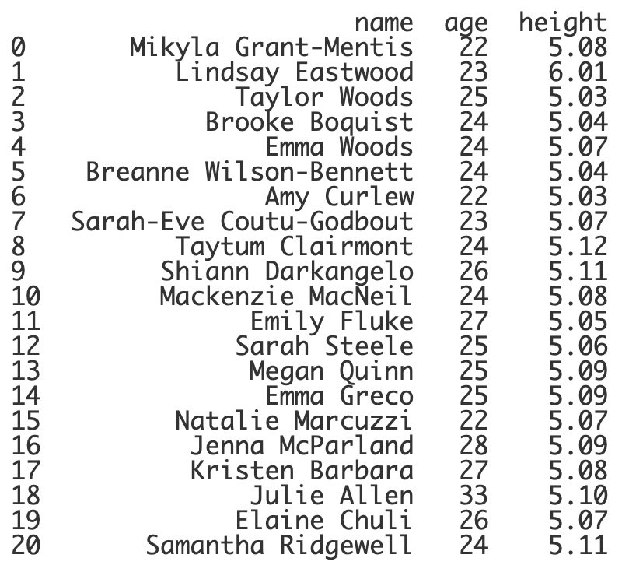
Incorrect Data Types
df.height = round(df.height, 2)
print(df[["name","age","height"]])
Notes:
We can always use the round function to denote how many decimal places to use in the float value. This probably would have been a better option to do with the age column - instead of converting the column values to integers. This way, the average age would have rounded up instead of the decimal portion being ignored.

Slide 26
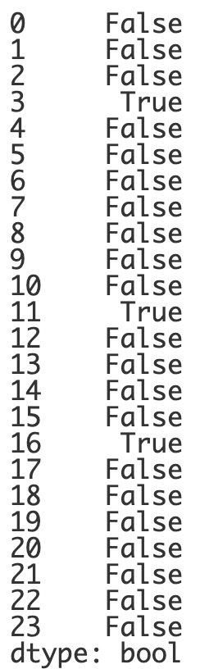
Duplicate Rows
print(df.duplicated())
What does it do?
Lists which rows are duplicate entries.
Notes:
One last data cleaning technique is to search for a remove duplicate values. I’ve duplicated a few values in the WNHL dataset to demonstrate this. The duplicated() function will list if the row already exists in the dataset. This would be messy to search through in a bigger dataset.

Slide 27
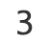
Duplicate Rows
print(df.duplicated().sum())
What does it do?
Lists how many duplicate rows there are in the dataset.
Notes:
We can add in the sum() function to find out how many duplicate rows there are. Looks like there are 3 that we should remove.

Slide 28
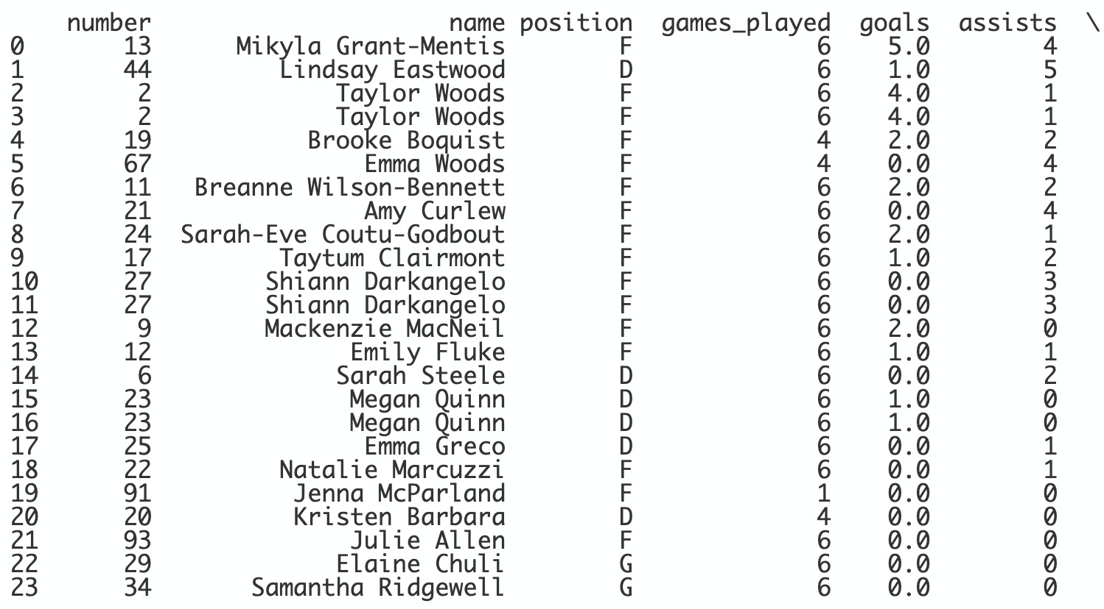
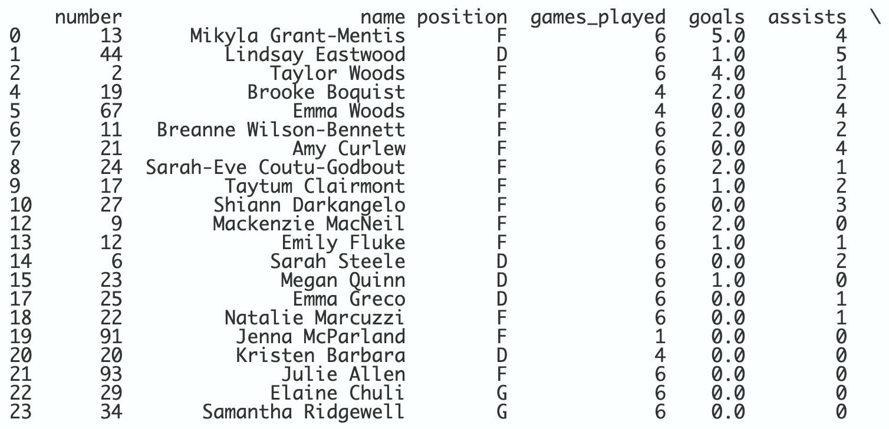
Duplicate Rows
print(df.drop_duplicates(inplace=True))
What does it do?
Drops all duplicate rows.
Notes:
The drop_duplicates function will drop all the duplicate rows. This function can really come in handy with bigger data sets. Here, you might be able to pinpoint the duplicates - but that might not be the case in a larger data set.

Slide 29
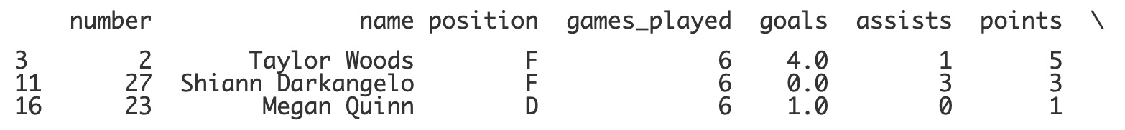
Duplicate Rows
print(df.loc[df.duplicated()])
Notes:
If you wanted to find the duplicate rows, we can use loc and search for only the rows that are duplicate rows.

Slide 30
Lesson Vocabulary
Term | Definition
data cleaning | The process of fixing or removing incorrect, corrupted, incorrectly formatted, duplicate, or incomplete data within a dataset.
imputation | The process of replacing missing data with substituted values.

Slide 31
Questions

Slide 32
What does the function df.isnull().sum() do?
Notes:
🍐 This is a Pear Deck Multiple Choice Slide. Your current options are: A: Lists which rows are duplicate entries., B: Fills missing values with a specific value., C: Drops all rows that have a missing value., D: Lists the number of null values in each column.,
🍐 To edit the type of question or choices, go back to the "Ask Students a Question" in the Pear Deck sidebar.
D

Slide 33
What should be added as a parameter to df.dropna() to drop columns instead of rows?
Notes:
🍐 This is a Pear Deck Multiple Choice Slide. Your current options are: A: axis=0, B: axis=1, C: inplace=True, D: method="column",
🍐 To edit the type of question or choices, go back to the "Ask Students a Question" in the Pear Deck sidebar.
B

Slide 34
Which of the following would change a value of 84.59 to 84 in the grade column?
Notes:
🍐 This is a Pear Deck Multiple Choice Slide. Your current options are: A: df.grade = round(df.grade, 0), B: df.grade = pd.to_numeric(df.grade), C: df.grade = df.grade.astype(int), D: df.grade.fillna(float),
🍐 To edit the type of question or choices, go back to the "Ask Students a Question" in the Pear Deck sidebar.
C

